Slide 1


Department of Electronics and Communication Engineering
VLSI Design
COURSE CODE
Topic:
CMOS Fabrication Process
Session - 4

Slide 2



AIM OF THE SESSION
To familiarize students with CMOS Fabrication Process.
INSTRUCTIONAL OBJECTIVES
This Session is designed to:
Discuss the design aspects CMOS inverter.
Describe the various steps of CMOS Fabrication steps..
LEARNING OUTCOMES
At the end of this session, you should be able to:
Discuss Fabrication Process of CMOS Technology.
Discuss Step wise Fabrication process of CMOS..
Summarize the all steps of CMOS Fabrication.

Slide 3

CMOS Fabrication Process
CMOS fabrication can be accomplished using either of the three technologies:
• N-well technologies/P-well technologies
• Twin well technology
• Silicon On Insulator (SOI)
The fabrication of CMOS can be done by following the below shown twenty steps,
--by which CMOS can be obtained by integrating both the NMOS and PMOS transistors on the same chip substrate.
For integrating these NMOS and PMOS devices on the same chip,
special regions called as wells or tubs are required
in which semiconductor type and substrate type are opposite to each other.
A P-well has to be created on a N-substrate or N-well has to be created on a P-substrate.
Here, the fabrication of CMOS is described using the P-substrate,
in which the NMOS transistor is fabricated on a P-type substrate and the PMOS transistor is fabricated in N-well.
The fabrication process involves twenty steps, which are as follows:

Slide 4


CMOS Fabrication Process
The fabrication process involves twenty steps, which are as follows:
Step1: Substrate
Primarily, start the process with a P-substrate.
Step2: Oxidation
The oxidation process is done by using high-purity oxygen and hydrogen,
which are exposed in an oxidation furnace approximately at 1000 degree centigrade.
N-Well Process

Slide 5

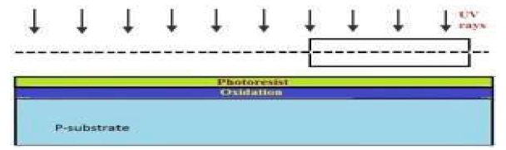
CMOS Fabrication Process
Step3: Photoresist
A light-sensitive polymer that softens whenever exposed to light is called as Photoresist layer. It is formed.
Step4: Masking
The photoresist is exposed to UV rays through the N-well mask

Slide 6


CMOS Fabrication Process
Step5: Photoresist removal
A part of the photoresist layer is removed by treating the wafer with the basic or acidic solution.
Step6: Removal of SiO2 using acid etching
The SiO2 oxidation layer is removed through the open area made by the removal of photoresist using hydrofluoric acid.

Slide 7


CMOS Fabrication Process
Step7: Removal of photoresist
The entire photoresist layer is stripped off, as shown in the below figure.
Step8: Formation of the N-well
By using ion implantation or diffusion process N-well is formed.

Slide 8

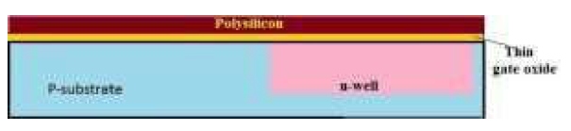
CMOS Fabrication Process
Step9: Removal of SiO2
Using the hydrofluoric acid, the remaining SiO2 is removed.
Step10: Deposition of polysilicon
Chemical Vapor Deposition (CVD) process is used to deposit a very thin layer of gate oxide.

Slide 9

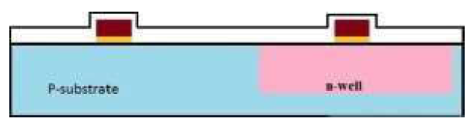
CMOS Fabrication Process
Step11: Removing the layer barring a small area for the Gates
Except the two small regions required for forming the Gates of NMOS and PMOS, the remaining layer is stripped off.
Step12: Oxidation process
Next, an oxidation layer is formed on this layer with two small regions for the formation of the gate terminals of NMOS and PMOS.

Slide 10

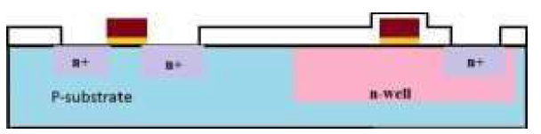
CMOS Fabrication Process
Step13: Masking and N-diffusion
By using the masking process small gaps are made for the purpose of N -diffusion.
The n-type (n+) dopants are diffused, or ion implanted, and the three n+ are formed for the formation of the terminals of NMOS.

Slide 11


CMOS Fabrication Process
Step14: Oxide stripping
The remaining oxidation layer is stripped off.
Step15: P-diffusion
Similar to the above N-diffusion process, the P-diffusion regions are diffused to form the terminals of the PMOS.

Slide 12
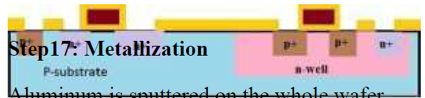
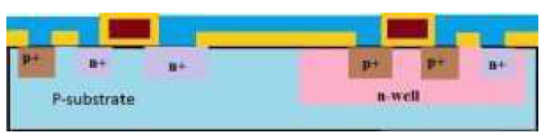
CMOS Fabrication Process
Step16: Thick field oxide
A thick-field oxide is formed in all regions except the terminals of the PMOS and NMOS.
Step17: Metallization
Aluminium is sputtered on the whole wafer.

Slide 13
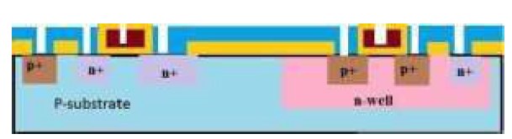

CMOS Fabrication Process
Step18: Removal of excess metal
The excess metal is removed from the wafer layer.
Step19: Terminals
The terminals of the PMOS and NMOS are made from respective gaps.

Slide 14
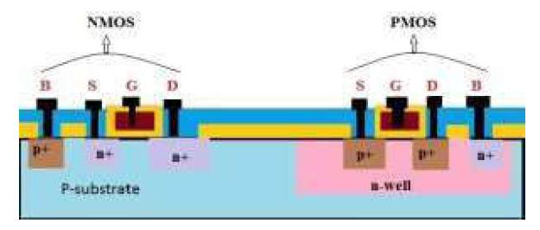
CMOS Fabrication Process
Step20: Assigning the names of the terminals of the NMOS and PMOS
Fabrication of CMOS using P-well process
Among all the fabrication processes of the CMOS, N-well process is mostly used for the fabrication of the CMOS.
P-well process is almost similar to the N-well.
But the only difference in p-well process is that it consists of a main N-substrate and,
thus, P-wells itself acts as substrate for the N devices.

Slide 15
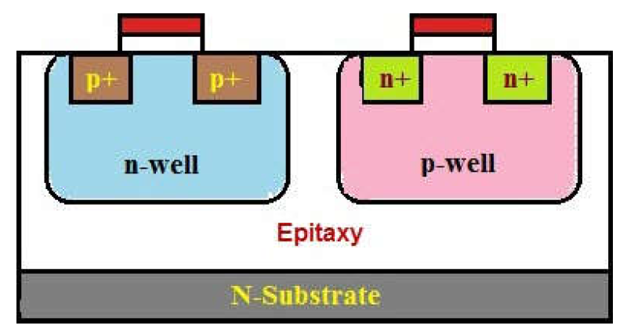
Twin tub-CMOS Fabrication Process
In this process, separate optimization of the n-type and p-type transistors will be provided.
The independent optimization of Vt, body effect and gain of the P-devices, N-devices can be made possible with this process.
Different steps of the fabrication of the CMOS using the twin-tub process are as follows:
• Lightly doped n+ or p+ substrate is taken and, to protect the latch up, epitaxial layer is used.
• The high-purity controlled thickness of the layers of silicon are grown with exact dopant concentrations.
• The dopant and its concentration in Silicon are used to determine electrical properties.
• Formation of the tub
• Thin oxide construction Implantation of the source and drain
• Cuts for making contacts
• Metallization
By using the above steps, we can fabricate CMOS using twin tub process method.

Slide 16
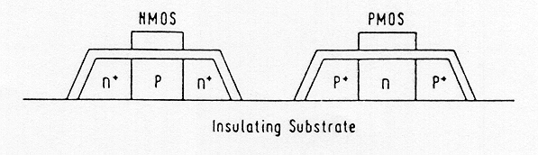
Silicon-on-Insulator (SOI) CMOS Process
Rather than using silicon as the substrate material,
Technologists have sought to use an insulating substrate to improve process characteristics such as
speed and latch-up susceptibility.
The SOI CMOS technology allows the creation of independent, completely isolated nMOS and pMOS transistors virtually side-by-side on an insulating substrate.
The main advantages of this technology are the higher integration density (because of the absence of well regions),
Complete avoidance of the latch-up problem, and
Lower parasitic capacitances compared to the conventional p & n-well or twintub CMOS processes.
A cross-section of nMOS and pMOS devicesusing SOI processis shown below.
The SOI CMOS process is considerably more costly than the standard p & n-well CMOS process.
Yet the improvements of device performance and the absence of latch-up problems can justify its use,
especially for deep-sub-micron devices.

Slide 17
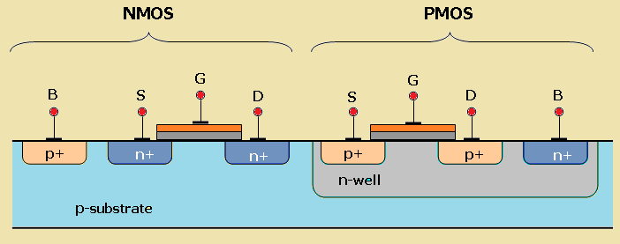
EXAMPLES of CMOS Fab Process Schematic

Slide 18
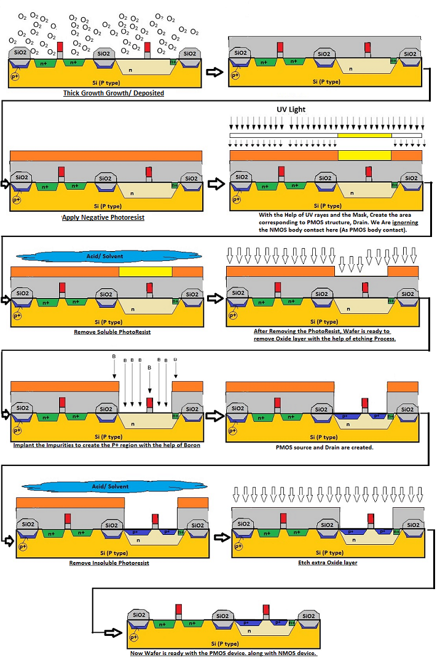
SUMMARY

Slide 19
SELF-ASSESSMENT QUESTIONS
1. What is main aspect fabrication design.
Device Design
Parameter simulation
Substrate Selection
All of Above
What is the effect of high K Oxide on Device Fabrication.
On Oxide thickness
Channel Length.
Well Diffusion
All Above

Slide 20
TERMINAL QUESTIONS
Draw the fabrication steps of CMOS transistor and explain its operation in detail.
Explain with neat diagrams the various NMOS fabrication technology.
Write about BiCMOS fabrication in a n-well process with a diagram.
Distinguish between Bipolar and CMOS devices technologies in brief.

Slide 21
REFERENCES FOR FURTHER LEARNING OF THE SESSION
Reference Books:
1. Sung-Mo Kong, Yusuf Leblebici, “CMOS Digital Integrated Circuits Analysis and Design” Third Edition.
2. Debaprasad Das, “CMOS DESIGN” Second Edition.

Slide 22
THANK YOU
Team – VLSI DESIGN

